Slide 1
Streptokinase
Anoushka Varerkar D-57

Slide 2
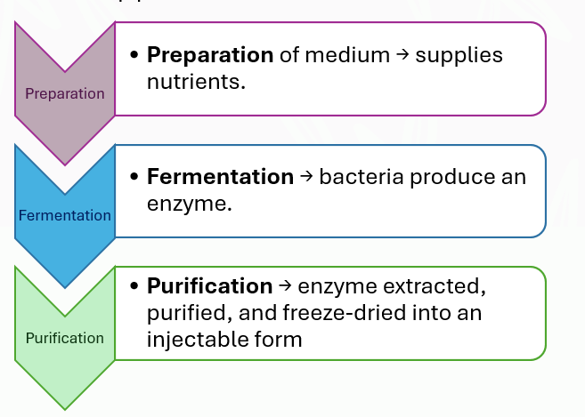
Streptokinase
Manufacturing Process
Streptokinase is used to dissolve blood clots that have formed in the blood vessels. It is used immediately after symptoms of a heart attack occur to improve patient survival. This medicine may also be used to treat blood clots in the lungs (pulmonary embolism) and in the legs (deep venous thrombosis).
Industry Example:
Companies like Sanofi, Cadila Pharmaceuticals, and Sun Pharma manufacture streptokinase formulations.
It’s a 3-step process :
Anoushka Varerkar A-18

Slide 3
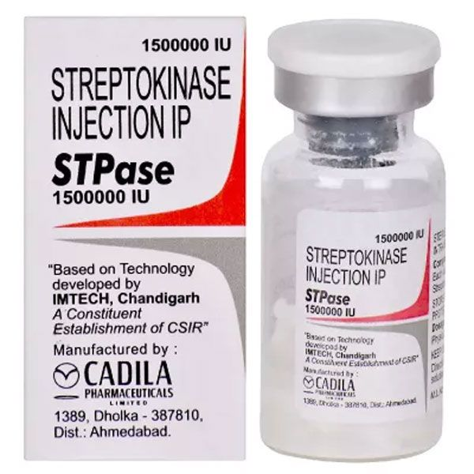
Final Product
Final Product: Streptokinase Injection (Clot-buster)
Industrial Applications:
Cardiology: Heart attack treatment (restores blood flow).
Pulmonology: Dissolves pulmonary emboli.
Emergency medicine: First-line therapy in hospitals worldwide.
https://www.drugssquare.com/others/stpase-1500000iu-injection/

Slide 4
Role of Computer Engineers
Computer engineers contribute significantly to pharmaceutical enzyme production:
• IoT-based Process Automation: Using sensors to sense, detect, and control the manufacturing process. Supervising bioreactors and fermentation using control systems.
• Data Analysis: Monitoring pH, temperature, oxygen levels, and enzyme yield
• Quality Control: Using AI/ML models to detect anomalies and ensure product consistency
• Cybersecurity: Protecting sensitive pharma production data and systems

Slide 5
References
https://www.sciencedirect.com/topics/biochemistry-genetics-and-molecular-biology/streptokinase
https://en.wikipedia.org/wiki/Streptokinase
https://www.mayoclinic.org/drugs-supplements/streptokinase-intravenous-route-intracoronary-route/description/drg-20070834
https://www.drugssquare.com/others/stpase-1500000iu-injection/
https://www.slideshare.net/slideshow/streptokinase-66365127/66365127

Slide 6
Thank you

